Slide 1
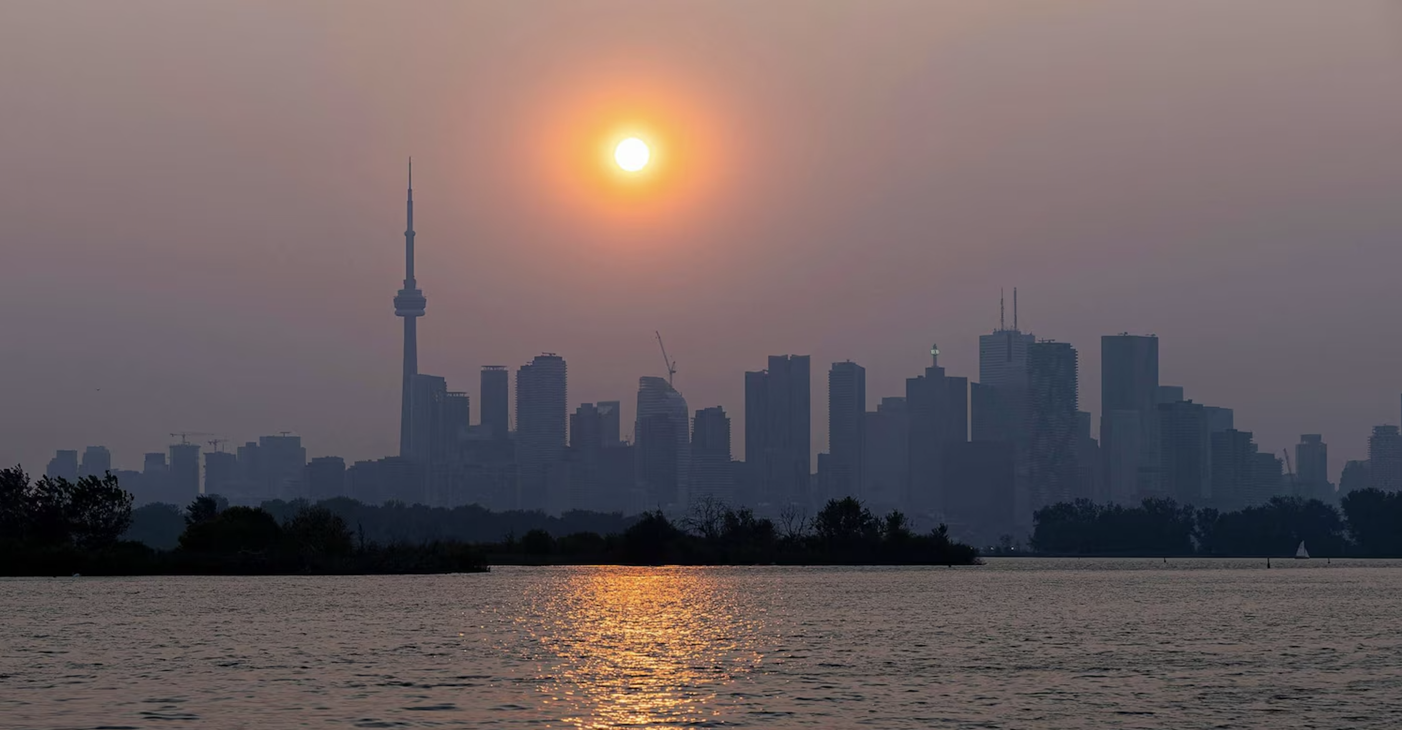
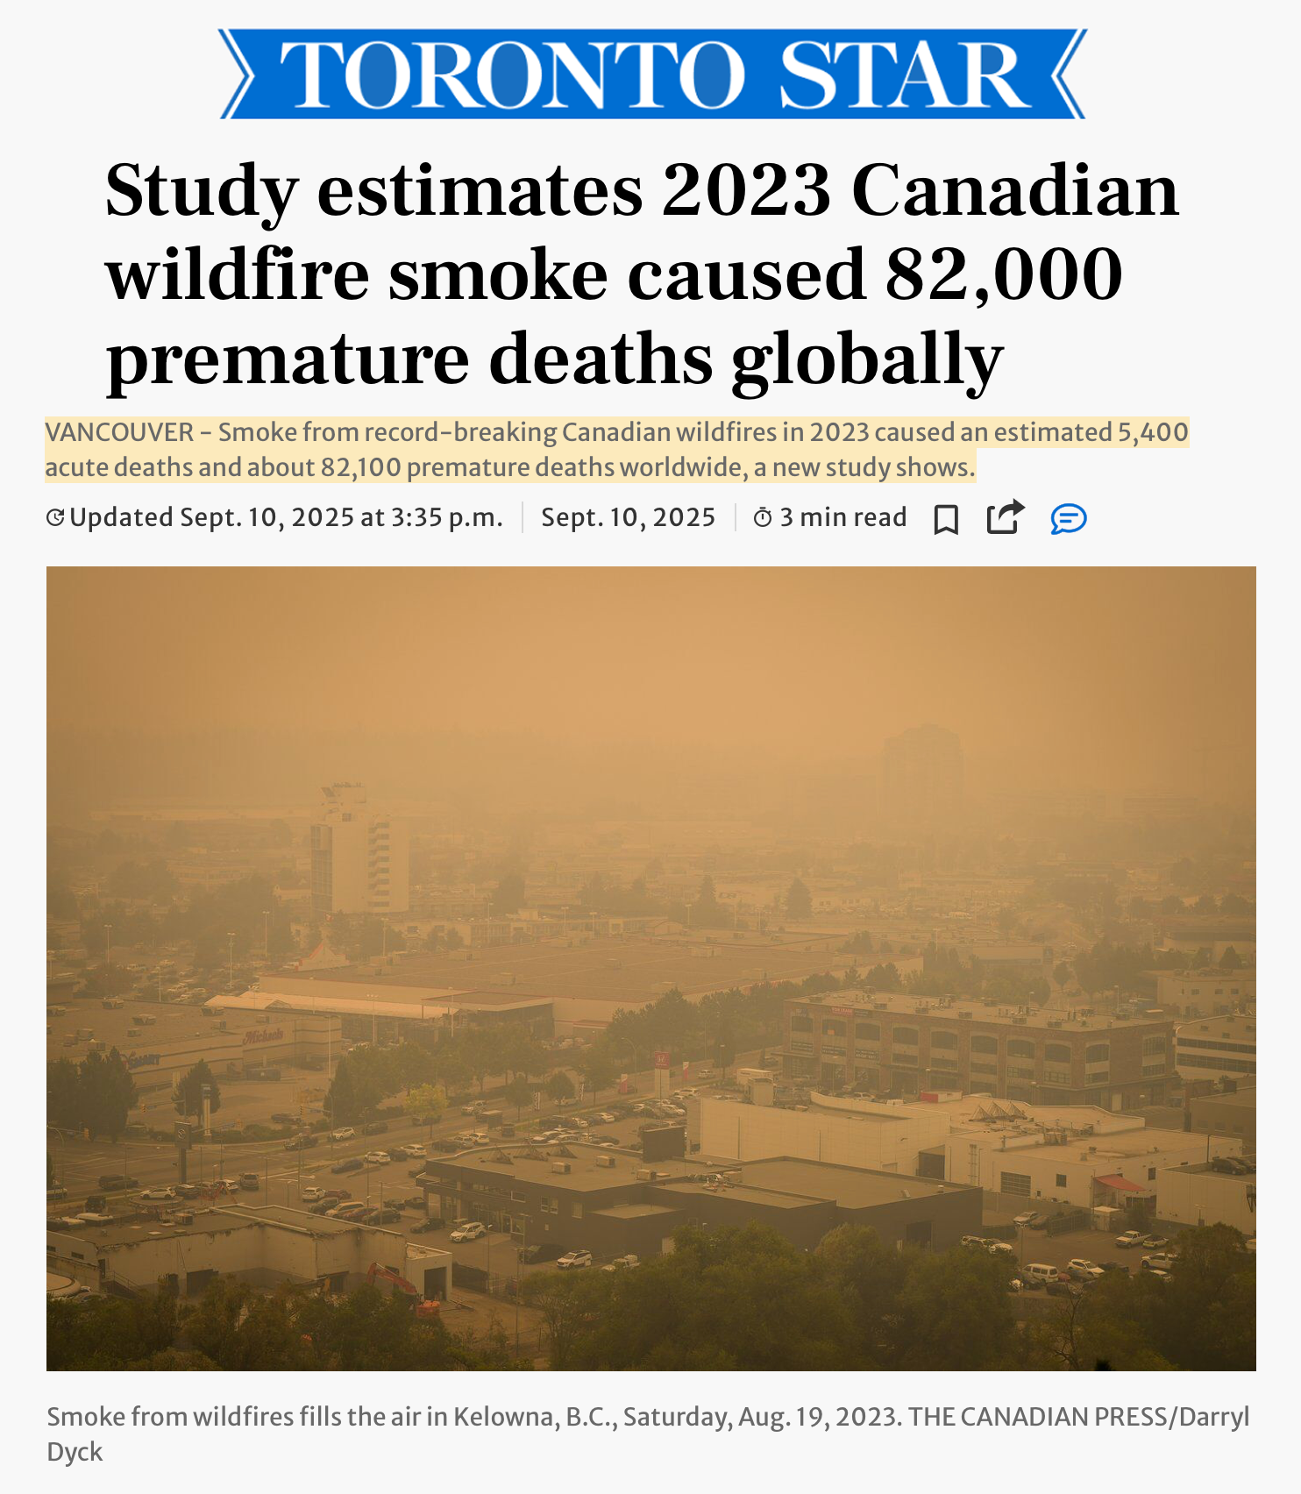
Our system could have provided a 6- 48 hours warning before this happened.
Wildfire smoke over the Toronto skyline, June 6, 2023.
Zou Zheng/Xinhua via Newscom
BEFORE THE SKY TURNS ORANGE The C.L.E.A.R. System: Canadian Lead-time Early Air Response Providing 6-48 Hours of Advance Warning for Wildfire Smoke Hugo Bui and Ryan Zander

